Slide 1
Few Dashboard Examples
RFQ Package - Procurement Process Digitalisation with AI - Production Materials and SRM

Slide 2
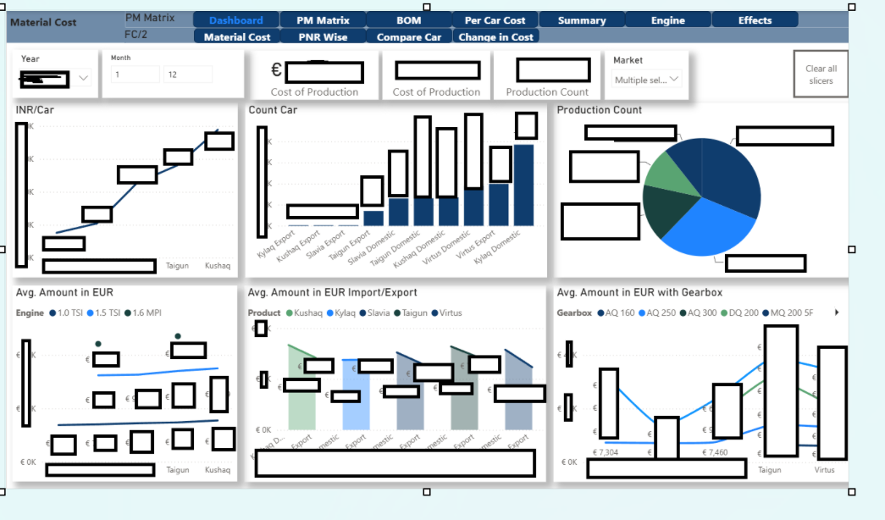

Slide 3
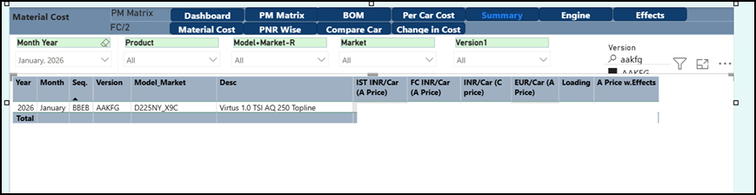

Slide 4
